Slide 1
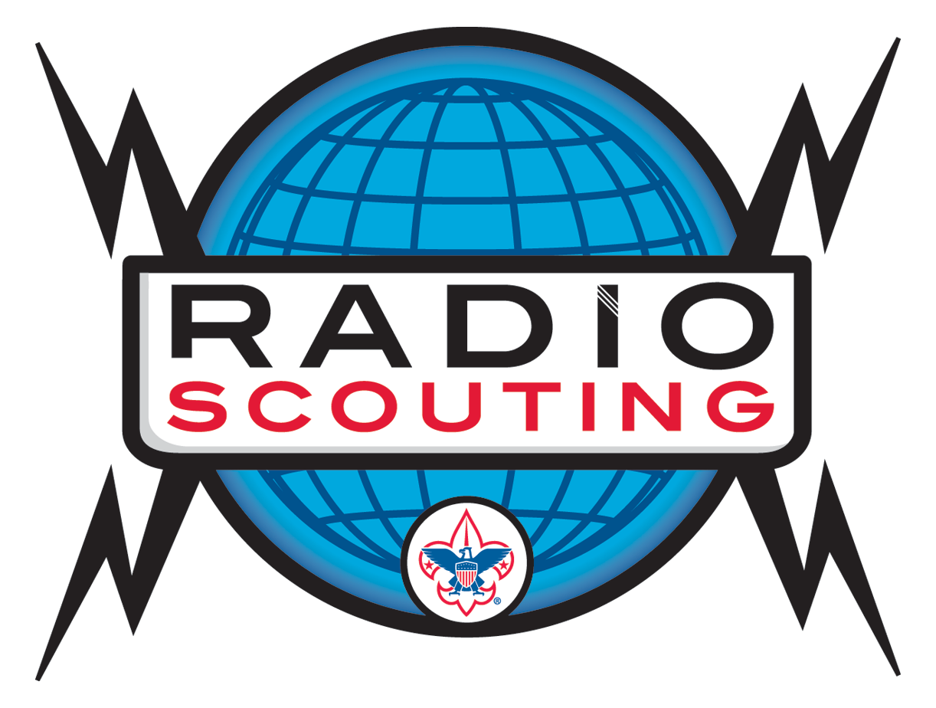
Jamboree on the Air Radio Scouting Update
Amateur Radio and Scouting

Slide 2
How many of you were involved in Scouting?

Slide 3
How many of you were influenced through Scouting to enter Amateur Radio?

Slide 4
How many of you are actively involved in Radio Scouting?

Slide 5
Radio Scouting Path
Introduction
Jamboree on the Air
Rank Advancement
Radio Merit Badge
Special Recognition
Morse Code Interpreter Strip
Amateur Radio Operator Rating Strip
ARRL Service to Scouting Award

Slide 6
Jamboree on the Air
3rd Weekend in October
World Wide Event
Started 1957
Now includes JOTI

Slide 7
World JOTA-JOTI
1.3 million participants
157 active countries
Nearly 20,000 radio amateurs
11,500+ stations

Slide 8
JOTA and JOTI

Slide 9
Top Countries 2014 | Participants From Reports
Brazil | 13,576
Portugal | 11,041
Malaysia | 8,570
Netherlands | 8,187
USA | 7,939
Australia | 6,889
Venezuela | 6,730
Mexico | 6,529
UK | 3,240
Oman | 1,990

Slide 10
USA Jamboree on the Air

Slide 11
2014 Results

Slide 12
How to organize a JOTA event
Work with your local Scout Council, District, or Unit.
See JOTA Talking points at http://www.k2bsa.net/talking-points/
Line up with an existing Scouting event that happens on JOTA weekend --- October 16-18, 2015
Go where the Scouts are as one more supporting activity for their event --- camporee, etc.

Slide 13
Resources
The go-to website http://www.scouting.org/jota.aspx
Leader guidelines, operator guidelines, planning and calendars, program ideas, success stories, activity books, participation certificates, graphics.
Supporting website is http://www.k2bsa.net
World JOTA-JOTI at http://www.jotajoti.info

Slide 14
Get on the Air – Get Involved

Slide 15
Radio Scouting

Slide 16
Radio Merit Badge
Introduced in 1918
7,208 Earned in 2013
Ranks # 73 out of ~ 135
Up from 1,000/year in 1990s

Slide 17
Morse Code Interpreter Strip
5 words per minute, send and receive
1,200 Sold in 2014
Ranks # 2 right after Español

Slide 18
Amateur Radio Operator Rating Strip
Do you have a license?
Sew it on.

Slide 19
ARRL Amateur Radio Service to Scouting Award
Adult Leaders
10 Requirements, Meet 5
Nomination to ARRL Section Manager
ARRL issues certificate
26 Issued to Date

Slide 20
Icom America Sponsorship
Started 2012
Renewed up to 2018
10 Scouting Loan Stations
2013 and 2017 Jamboree
3 Repeaters at the Summit
Jamboree on the Air

Slide 21
K2BSA Amateur Radio Association
Call Sign Established in 1971
Association Constitution and 501c3 in 1987
Operates National Jamboree Station
Call Sign Available for Scouting Events
Lifetime Membership $12

Slide 22
It’s all about the next generation of hams.

Slide 23
More Information
K2BSA Website — www.K2BSA.net
K2BSA Facebook Page — K2BSA.Scouting
K2BSA Twitter — K2BSA_Scouting
USA JOTA — www.Scouting.org/JOTA
World JOTA-JOTI — www.jotajoti.info
Jim Wilson, K5ND — jim.wilson@k2bsa.net

